Slide 1

Progressive Web App

Slide 2
IndexedDB
IndexedDB provides an object store in the browser
Non-relational database
Stores: JS objects, files, blobs, etc.

Slide 3
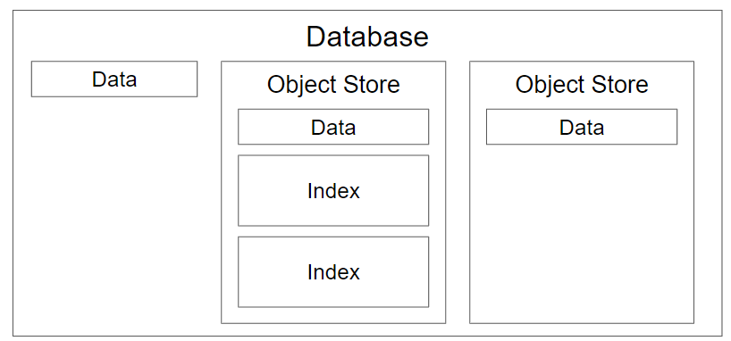
IndexedDB Structure

Slide 4
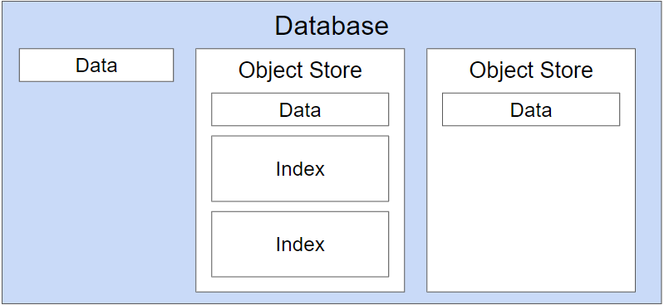
Opening a database
idb.open(name, version, {upgradeCallback})

Slide 5
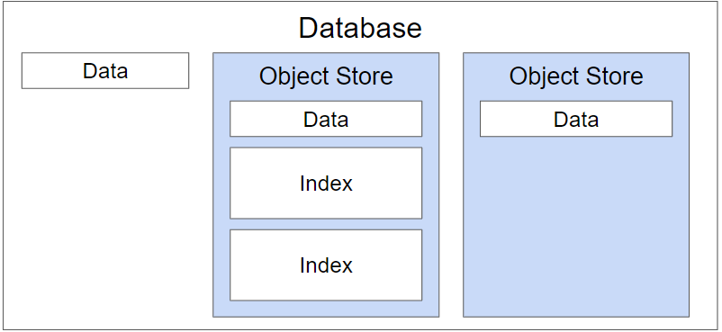
Create object stores

Slide 6
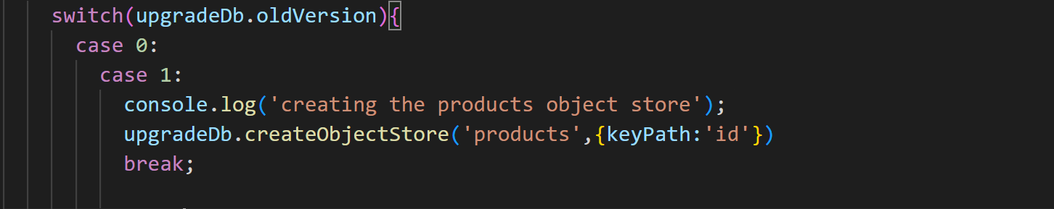
Create an object store

Slide 7
Defining primary key
upgradeDb.createObjectStore('people', {keyPath: 'email’});
upgradeDb.createObjectStore('notes', {autoIncrement:true});
upgradeDb.createObjectStore('logs', {keyPath: 'id', autoIncrement:true});

Slide 8
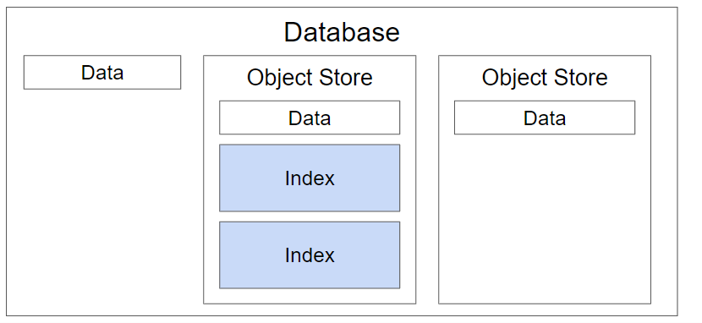
Adding indexes

Slide 9
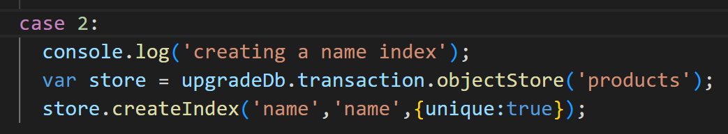
Defining indexes example

Slide 10
Working with data

Slide 11
Operations
Add
Get
Put
Delete
getAll
cursor

Slide 12
Transactions
A wrapper around a series of operations.
To ensure database integrity, all data manipulation functions (create, read, update and delete) must happen inside a transaction.
A transaction can be thought of as a safe wrapper around an operation or group of operations: If one of the actions within a transaction fail, all of the actions are rolled back.
Transactions are specific to one or more object stores, which we define when we open the transaction.
They can be read-only or read and write. This signifies whether the operations inside the transaction are reading data or making a change to the database.

Slide 13
Working with data
Each data operation has this form:
Get database object from idb.open
Open transaction on database
Open object store on transaction
Optionally open index on object store
Perform operation on object store or index

Slide 14
Add data
The example code:
Calls dbPromise (idb.open) which resolves to the database object
Creates a transaction on the database object, defining the ‘products’ object store as it’s scope
Opens the ‘products’ object store on the transaction
Add all products object to the object store

Slide 15
Read data
We first create a read-only transaction for the store objectStore.
We then open the object store on the transaction and assign the resulting object store object to a variable.
Finally, we return the content of the store

Slide 16
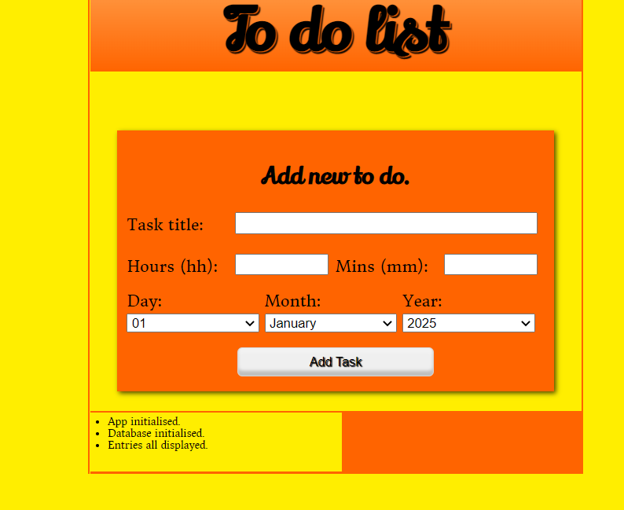
Assignment

